Slide 1

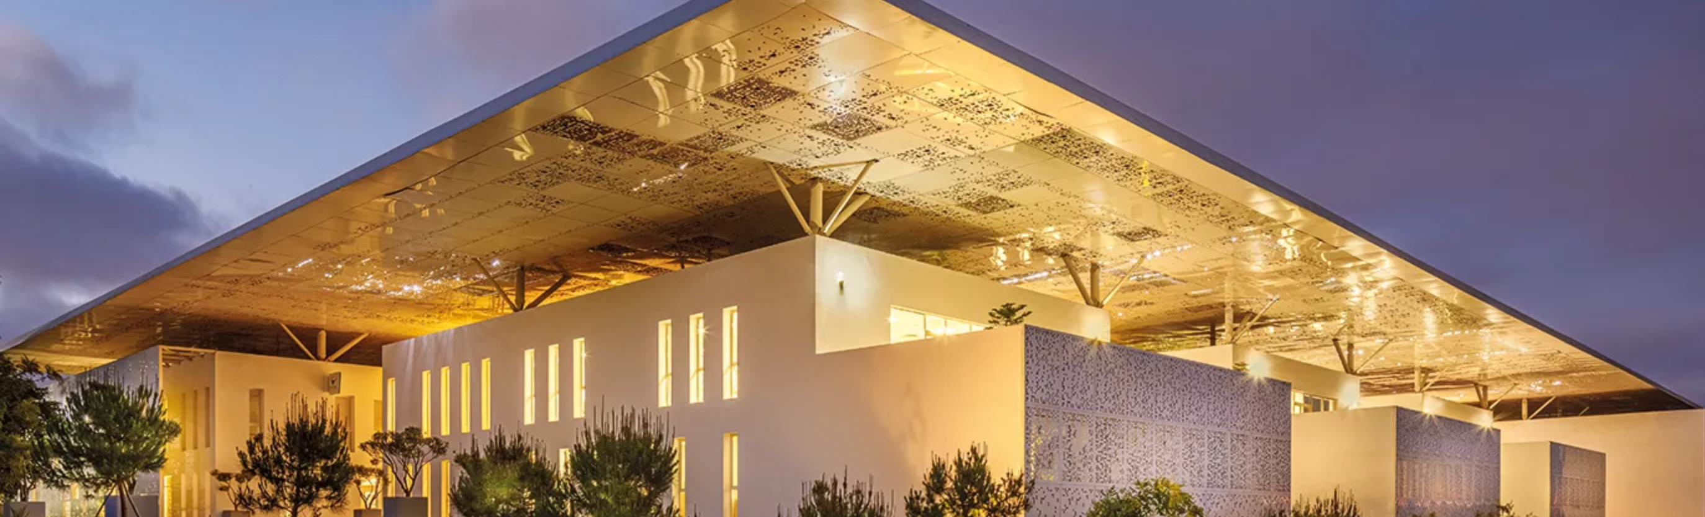
Modern NLP
Based on Deep Learning and Language models.
Day 2 Morning
Alexandre Gazagnes

Slide 2
2nd Day
Morning (~ 2h)
Smallest remainder of Day 1
King – Man + Woman
Using advanced embedding techniques
Afternoon (~ 4h)
Gentle introduction to delivery API + front End
Transfert learning
Fine Tuning
Alexandre Gazagnes
Alexandre Gazagnes

Slide 3
First … Let’s Talk !
Alexandre Gazagnes

Slide 4
Small Remainder
Project and goups
VSCode / PyCharm
Github Account
OpenAI GPT API Key
Exam
Alexandre Gazagnes

Slide 5
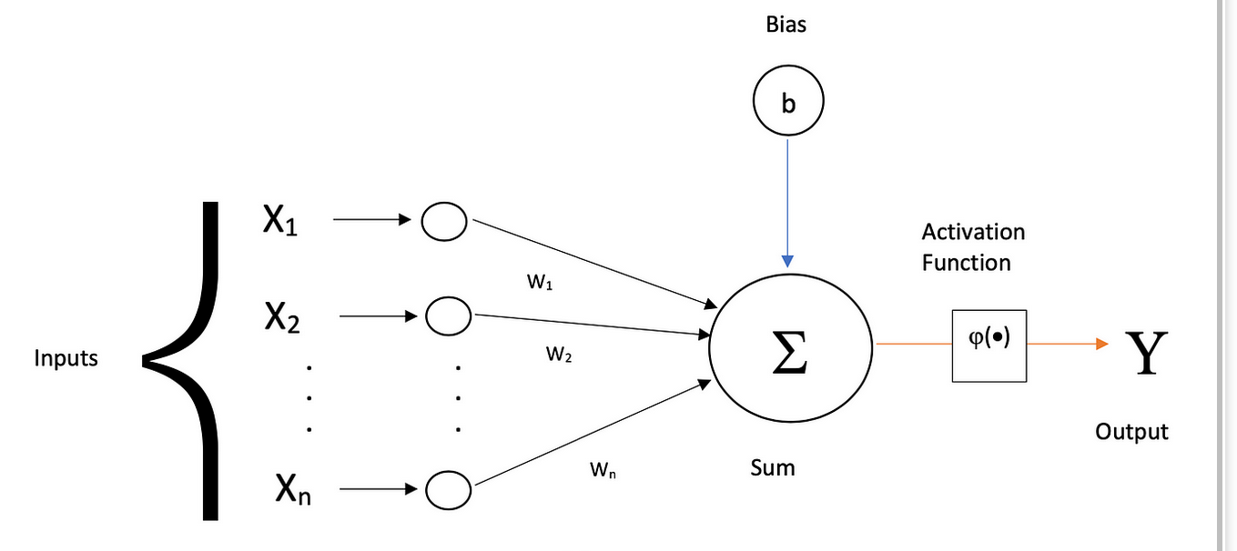
What is a Deep Learning Neural Network ?
Deep learning is a subfield of machine learning that focuses on using neural networks with many layers—hence the term "deep."
Deep learning has been behind many recent
advancements in areas like computer vision, natural
language processing, and audio recognition.
Differences between Deep Learning and
Classical Machine Learning : Model Complexity /
Feature Engineering / Handling Unstructured Data / Scalability with Data / Interpretability ...
Alexandre Gazagnes

Slide 6
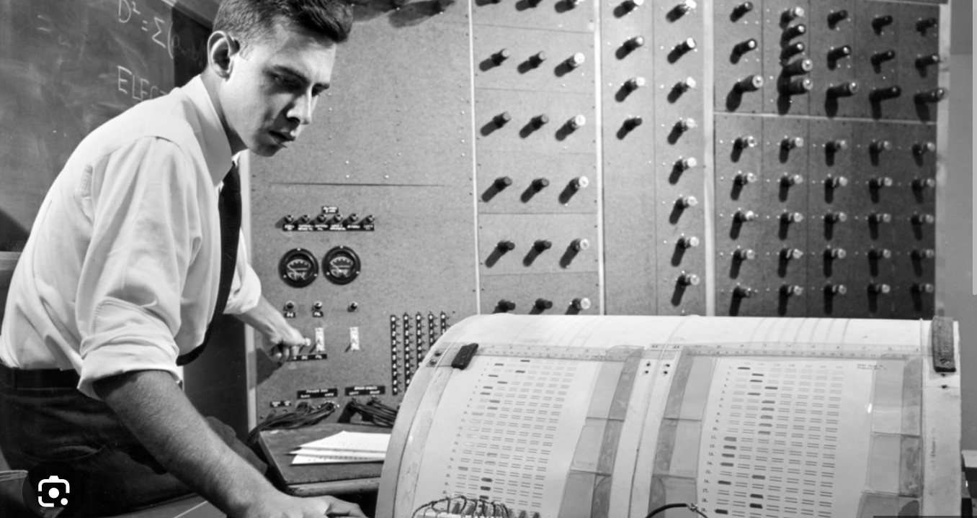
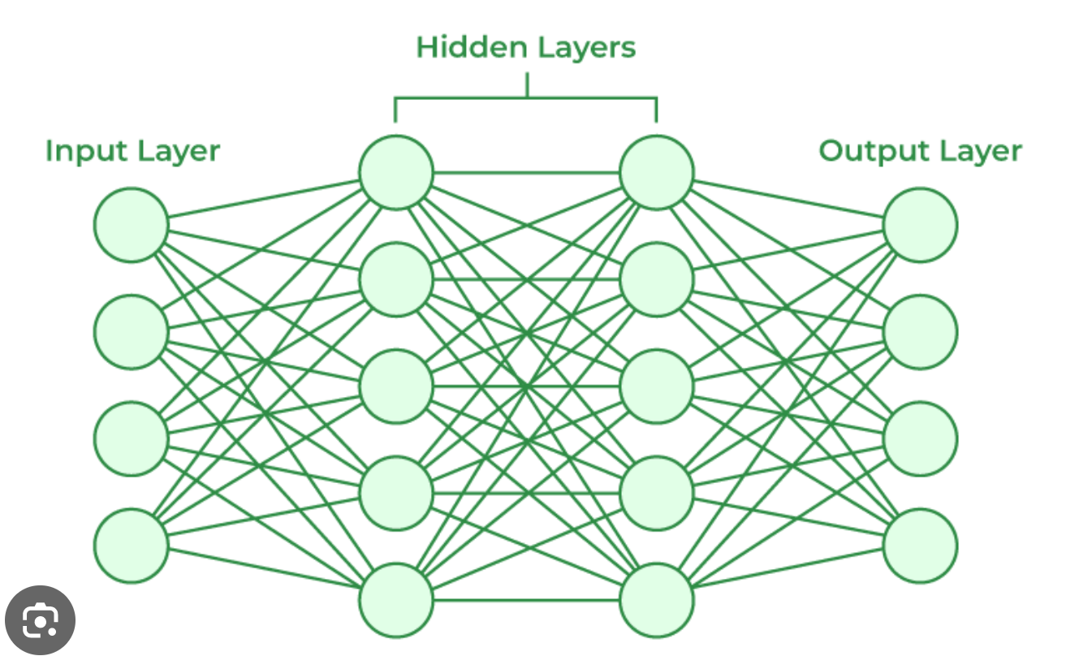
The Very First ‘not so deep’ Neural Network
Alexandre Gazagnes

Slide 7
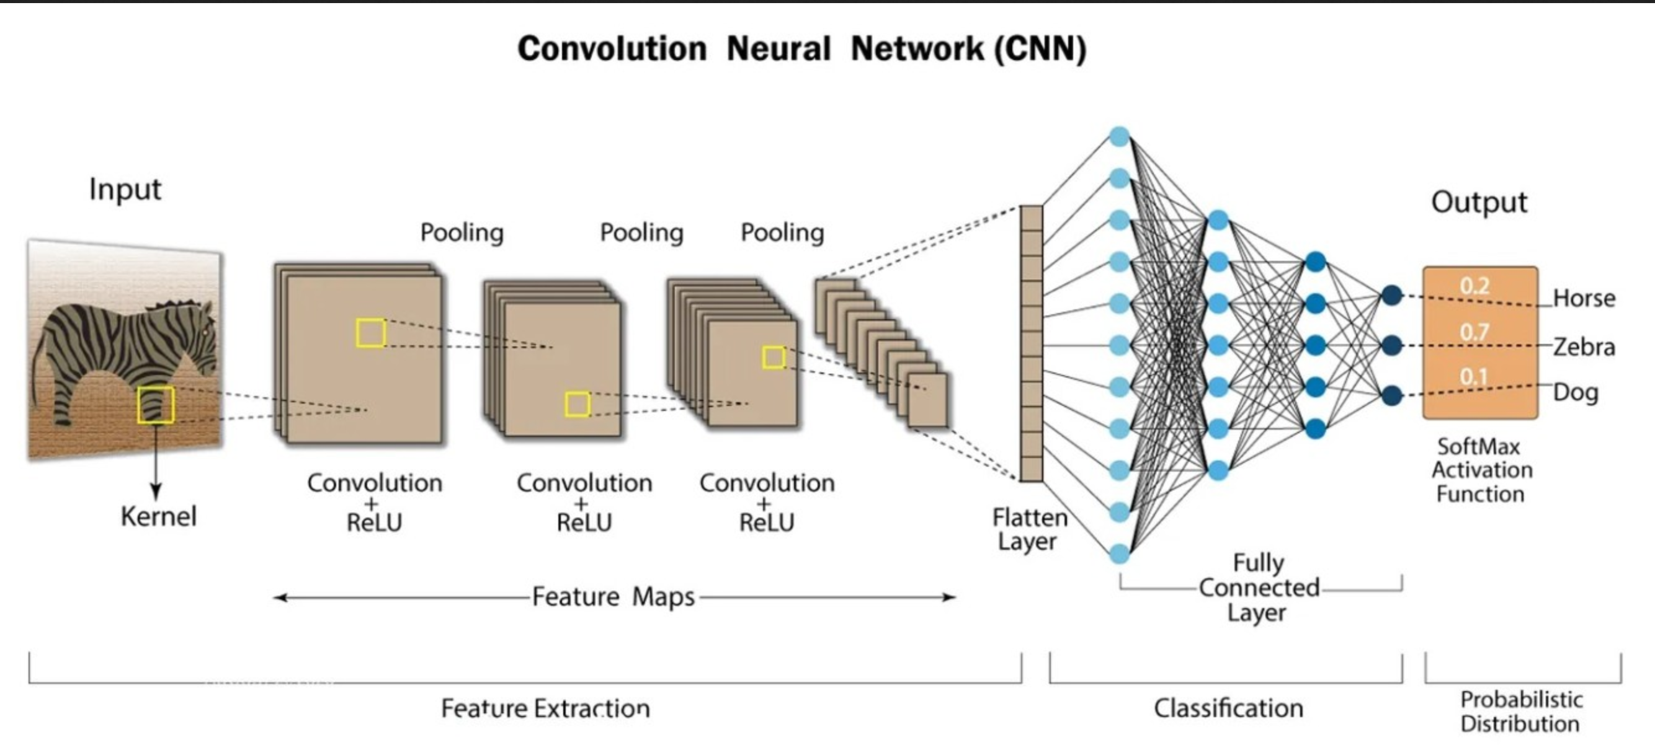
Most famous network : the CNN
Alexandre Gazagnes

Slide 8
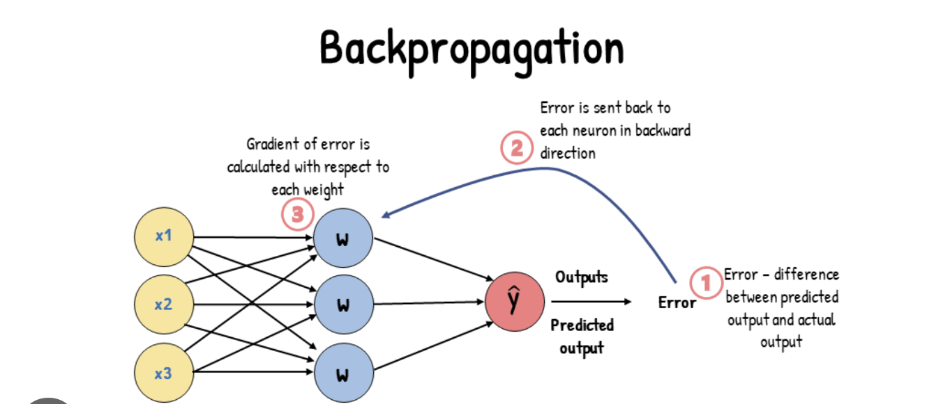
Most important Feature in DL
Alexandre Gazagnes

Slide 9
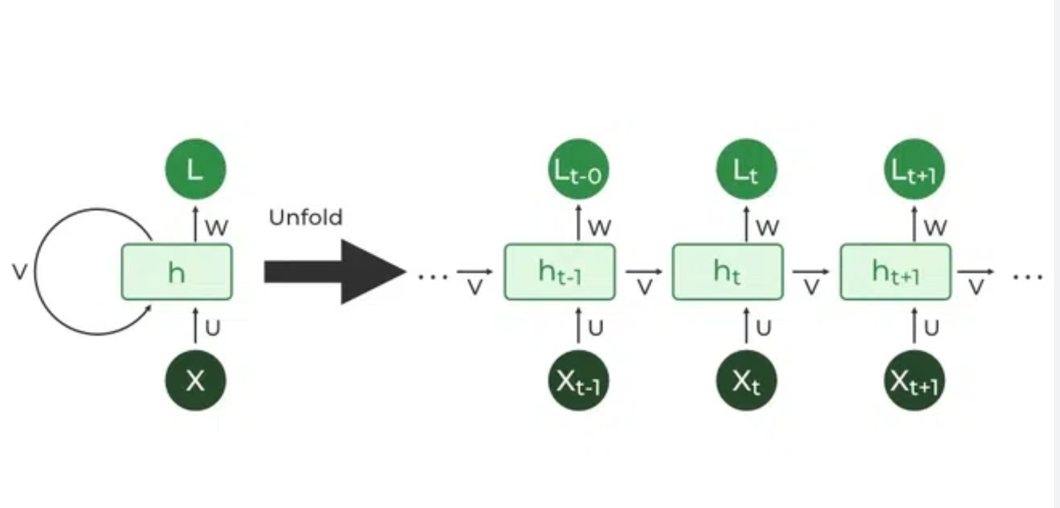
Better for NLP : The RNN
Alexandre Gazagnes

Slide 10
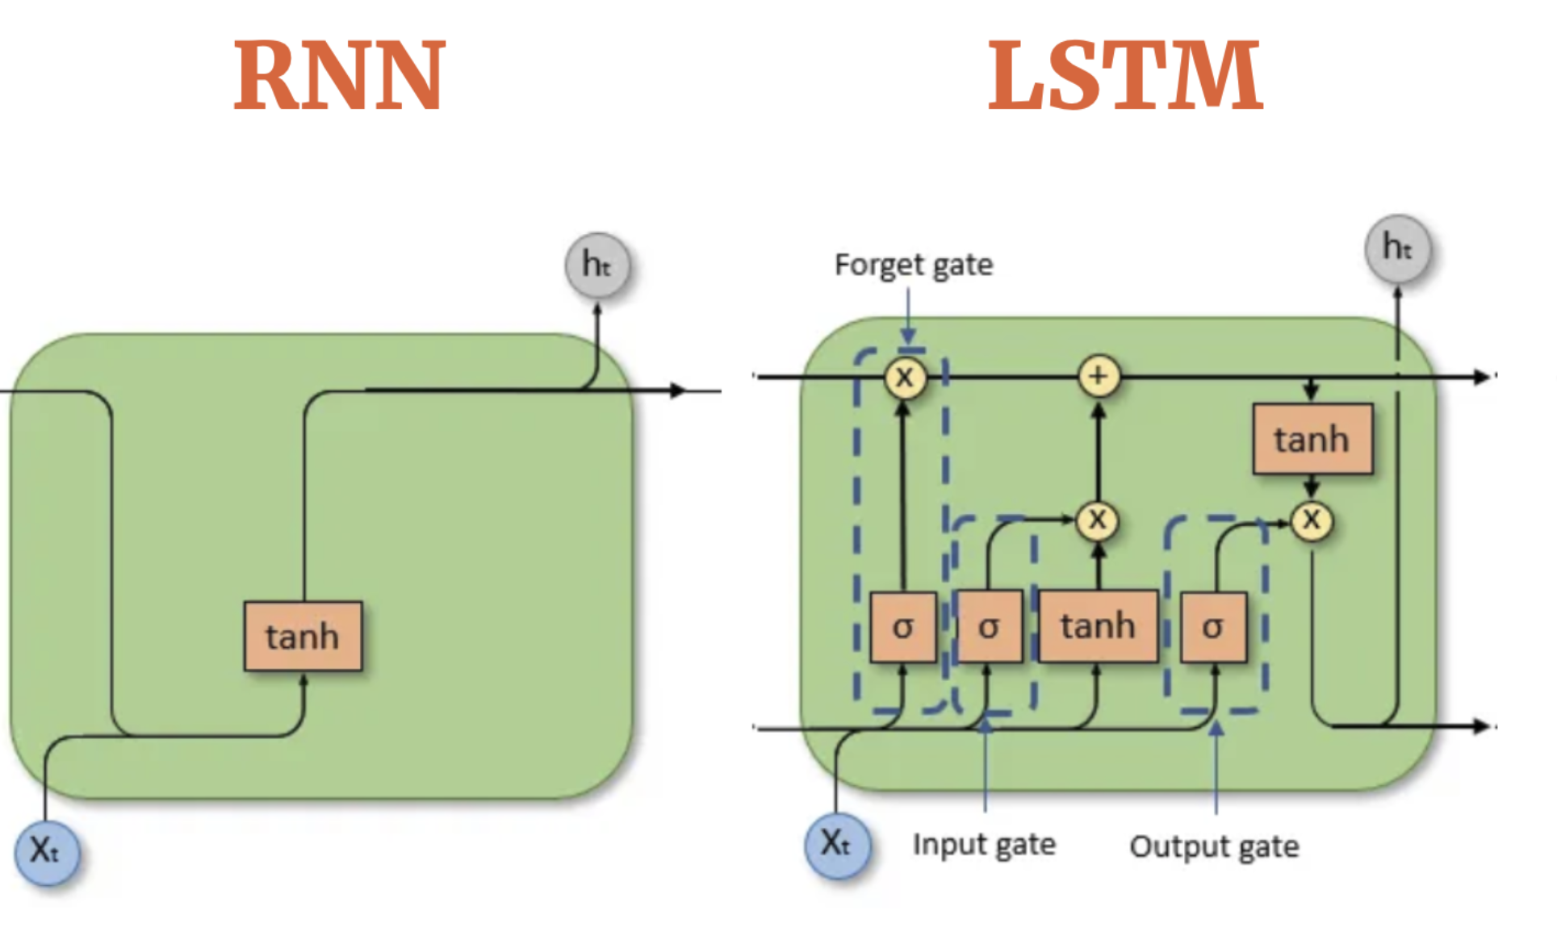
From RNN to LSTM
Alexandre Gazagnes

Slide 11
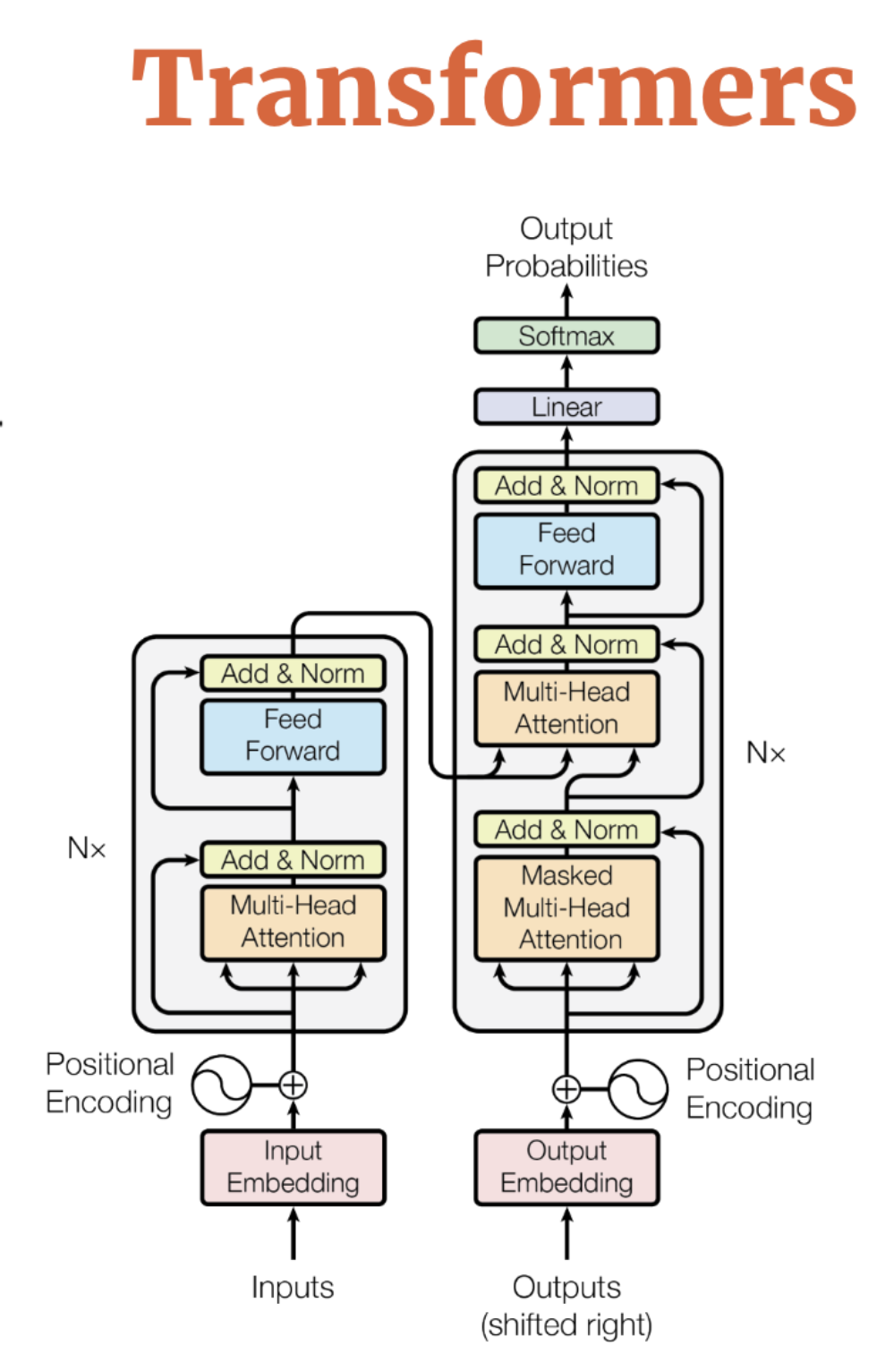
From LSTM to...
Attention is All You Need
Employs self-attention mechanisms to assign varying degrees of importance to different words in a sentence, independently of their positions within the sequence.
Processes entire sequences of data in parallel, which significantly speeds up training and enhances the model's ability to handle long-range dependencies.
Does not use any recurrent architecture (no data flow from one time step to the next), unlike LSTM.

Slide 12
Practice !

Slide 13
Annexes
Alexandre Gazagnes

Slide 14
About Deep Learning
https://www.fast.ai/
https://www.youtube.com/@CNRS-FIDLE
https://www.deeplearning.ai
https://feedly.com/ (Intell)
Alexandre Gazagnes

